Slide 1
Introduction to Topic Modeling
Ramesh Ragala
Assistant Professor (Senior)
VIT Chennai

Slide 2
Introduction to Topic Modeling
Automatically extract topics from text documents
Topic ~ main idea discussed in text data
Theme/subject of a discussion or conversation
Different granularities (e.g: topic of a sentence, an article, etc)
Many applications requires discovery of topics in text
What are the tweets users talking about today?
What are the current research topics in data mining? How are they different from those 5 years ago?
What do people like about the iPhone?
Notes:
First, let's define NER!
go through pages, recognize the names of things: "Bill MacCartney", "Stanford University"
the people who came up with this task had a rather precise, philosophically motivated meaning in mind
entity: a discrete, actual thing: Bill MacCartney, but not calcium carbonate or Tuesday or Viagra
named entity: an entity with a name, in a philosophical, Kripke-like sense
(this water bottle is an entity, but not a NAMED entity)
but in practice the definition has been expanded quite a bit in later work
we routinely include dates & times, proteins, drug names
but still, loosely, things that have a name
but NOT references to entities which are not names: "this university", "it”
first task in NER: identifying occurrences of named entities
looking for capital letters is a really good clue! at least in English! but not so much in Hebrew, Chinese, ... non-Latinate alphabets also doesn't really work in German -- all nouns are capitalized!
so that's a pretty useful base-level task -- widely deployed and used
you've probably seen web pages that do this
e.g. financial web sites often mark up stock symbols, names of companies
Microsoft has done work with this, smart tags, entities tagged with metadata
Reuters has web service OpenCalais, you send them docs, they send back NER markup

Slide 3
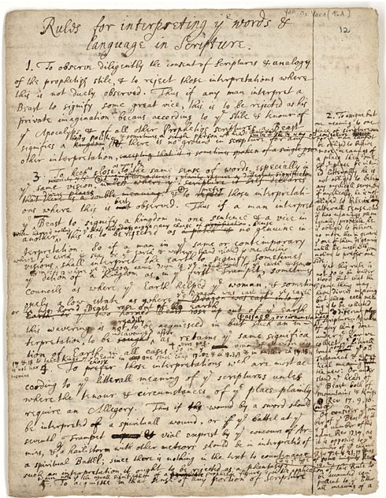
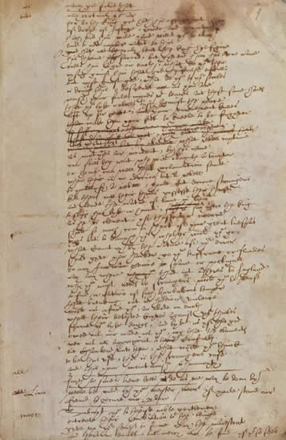
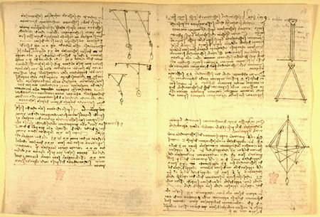
What is a Topic?
Representation: a probabilistic distribution over words.
retrieval 0.2
information 0.15
model 0.08
query 0.07
language 0.06
feedback 0.03
……
Topic: A broad concept/theme, semantically coherent, which is hidden in documents
e.g., politics; sports; technology; entertainment; education etc.

Slide 4
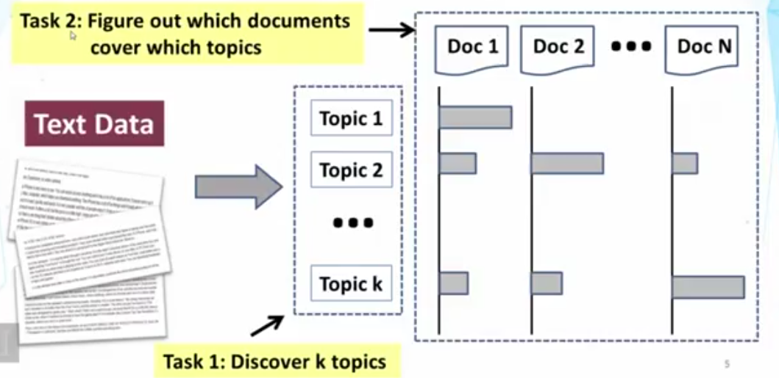
Tasks of Topic mining and analysis

Slide 5
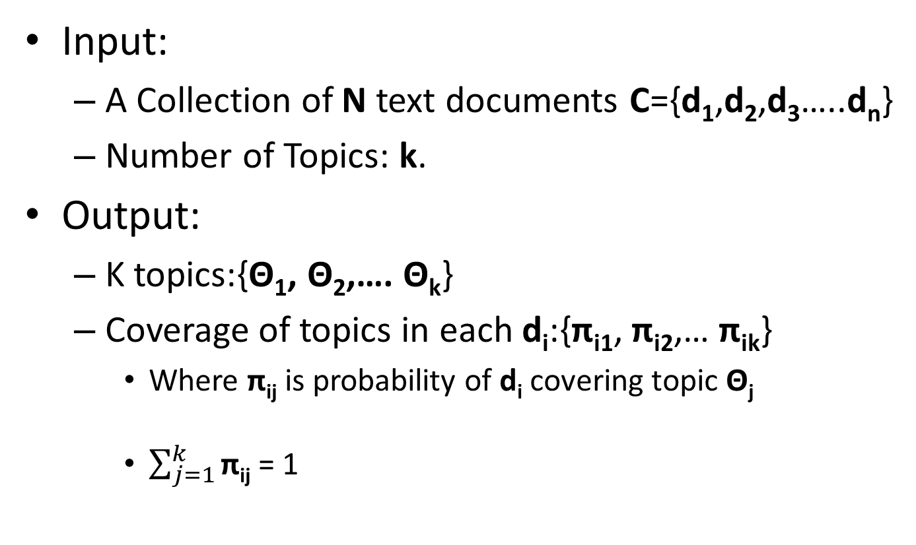
Formal Definition of Topic Mining and Analysis
Input:
A Collection of N text documents C={d₁,d₂,d₃…..d_{n}}
Number of Topics: k.
Output:
K topics:{Θ₁, Θ₂,…. Θ_{k}}
Coverage of topics in each d_{i}:{π_{i1}, π_{i2},… π_{ik}}
Where π_{ij} is probability of d_{i} covering topic Θ_{j}
$\sum_{j=1}^{k}{\text{π}\text{ij}}$ = 1
How to define Θ_{i} ?
Notes:
First, let's define NER!
go through pages, recognize the names of things: "Bill MacCartney", "Stanford University"
the people who came up with this task had a rather precise, philosophically motivated meaning in mind
entity: a discrete, actual thing: Bill MacCartney, but not calcium carbonate or Tuesday or Viagra
named entity: an entity with a name, in a philosophical, Kripke-like sense
(this water bottle is an entity, but not a NAMED entity)
but in practice the definition has been expanded quite a bit in later work
we routinely include dates & times, proteins, drug names
but still, loosely, things that have a name
but NOT references to entities which are not names: "this university", "it”
first task in NER: identifying occurrences of named entities
looking for capital letters is a really good clue! at least in English! but not so much in Hebrew, Chinese, ... non-Latinate alphabets also doesn't really work in German -- all nouns are capitalized!
so that's a pretty useful base-level task -- widely deployed and used
you've probably seen web pages that do this
e.g. financial web sites often mark up stock symbols, names of companies
Microsoft has done work with this, smart tags, entities tagged with metadata
Reuters has web service OpenCalais, you send them docs, they send back NER markup

Slide 6
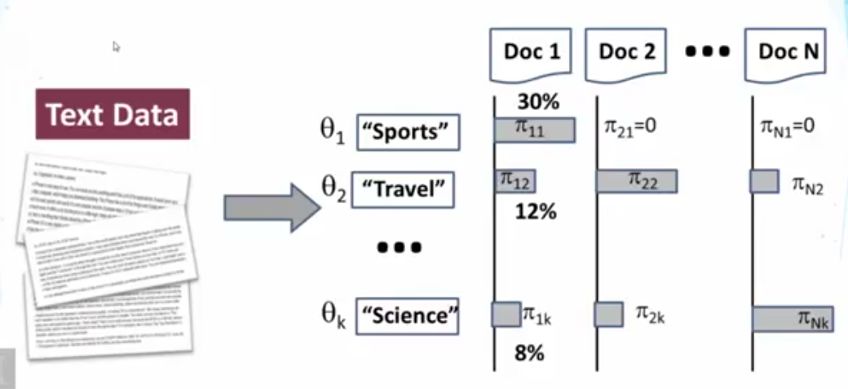
Introduction to Topic Modeling
Initial idea : topic = term (a term can be word or phrase)
Notes:
First, let's define NER!
go through pages, recognize the names of things: "Bill MacCartney", "Stanford University"
the people who came up with this task had a rather precise, philosophically motivated meaning in mind
entity: a discrete, actual thing: Bill MacCartney, but not calcium carbonate or Tuesday or Viagra
named entity: an entity with a name, in a philosophical, Kripke-like sense
(this water bottle is an entity, but not a NAMED entity)
but in practice the definition has been expanded quite a bit in later work
we routinely include dates & times, proteins, drug names
but still, loosely, things that have a name
but NOT references to entities which are not names: "this university", "it”
first task in NER: identifying occurrences of named entities
looking for capital letters is a really good clue! at least in English! but not so much in Hebrew, Chinese, ... non-Latinate alphabets also doesn't really work in German -- all nouns are capitalized!
so that's a pretty useful base-level task -- widely deployed and used
you've probably seen web pages that do this
e.g. financial web sites often mark up stock symbols, names of companies
Microsoft has done work with this, smart tags, entities tagged with metadata
Reuters has web service OpenCalais, you send them docs, they send back NER markup

Slide 7
Introduction to Topic Modeling
Mining K-topical terms from collection – C → many techniques are available
Parse text in text data to obtain candidate terms → e.g: term= word
Design a scoring function to measure how good each term is as a topic.
Favor a representation term (high frequency is favor)
Avoid words that are too frequent (eg: a, the)
TF-IDF weighting from retrieval can be very useful
Domain-specific heuristics are possible (eg: favor title words, hashtags in tweets)
Pick k-terms with highest scores but try to minimize redundancy
If multiple terms are very similar or closely related → pick one
Notes:
First, let's define NER!
go through pages, recognize the names of things: "Bill MacCartney", "Stanford University"
the people who came up with this task had a rather precise, philosophically motivated meaning in mind
entity: a discrete, actual thing: Bill MacCartney, but not calcium carbonate or Tuesday or Viagra
named entity: an entity with a name, in a philosophical, Kripke-like sense
(this water bottle is an entity, but not a NAMED entity)
but in practice the definition has been expanded quite a bit in later work
we routinely include dates & times, proteins, drug names
but still, loosely, things that have a name
but NOT references to entities which are not names: "this university", "it”
first task in NER: identifying occurrences of named entities
looking for capital letters is a really good clue! at least in English! but not so much in Hebrew, Chinese, ... non-Latinate alphabets also doesn't really work in German -- all nouns are capitalized!
so that's a pretty useful base-level task -- widely deployed and used
you've probably seen web pages that do this
e.g. financial web sites often mark up stock symbols, names of companies
Microsoft has done work with this, smart tags, entities tagged with metadata
Reuters has web service OpenCalais, you send them docs, they send back NER markup

Slide 8
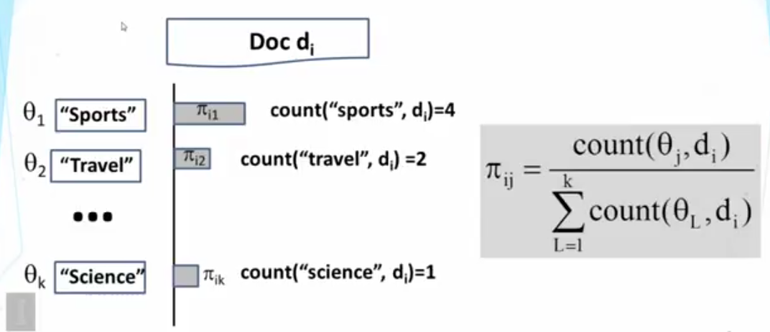
Introduction to Topic Modeling
Computing Topic Coverage: π_{ij}
Notes:
First, let's define NER!
go through pages, recognize the names of things: "Bill MacCartney", "Stanford University"
the people who came up with this task had a rather precise, philosophically motivated meaning in mind
entity: a discrete, actual thing: Bill MacCartney, but not calcium carbonate or Tuesday or Viagra
named entity: an entity with a name, in a philosophical, Kripke-like sense
(this water bottle is an entity, but not a NAMED entity)
but in practice the definition has been expanded quite a bit in later work
we routinely include dates & times, proteins, drug names
but still, loosely, things that have a name
but NOT references to entities which are not names: "this university", "it”
first task in NER: identifying occurrences of named entities
looking for capital letters is a really good clue! at least in English! but not so much in Hebrew, Chinese, ... non-Latinate alphabets also doesn't really work in German -- all nouns are capitalized!
so that's a pretty useful base-level task -- widely deployed and used
you've probably seen web pages that do this
e.g. financial web sites often mark up stock symbols, names of companies
Microsoft has done work with this, smart tags, entities tagged with metadata
Reuters has web service OpenCalais, you send them docs, they send back NER markup

Slide 9
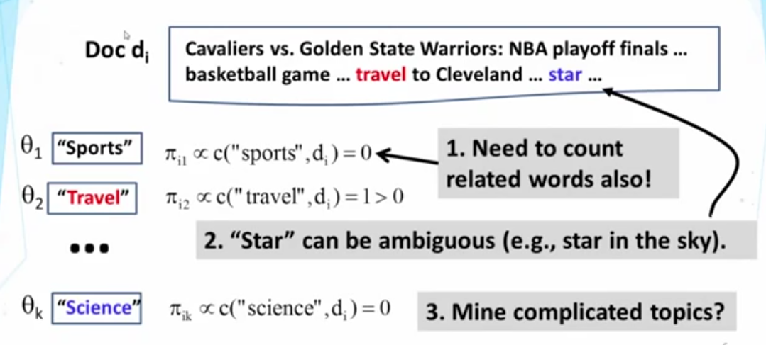
Introduction to Topic Modeling
Evolution:
Notes:
First, let's define NER!
go through pages, recognize the names of things: "Bill MacCartney", "Stanford University"
the people who came up with this task had a rather precise, philosophically motivated meaning in mind
entity: a discrete, actual thing: Bill MacCartney, but not calcium carbonate or Tuesday or Viagra
named entity: an entity with a name, in a philosophical, Kripke-like sense
(this water bottle is an entity, but not a NAMED entity)
but in practice the definition has been expanded quite a bit in later work
we routinely include dates & times, proteins, drug names
but still, loosely, things that have a name
but NOT references to entities which are not names: "this university", "it”
first task in NER: identifying occurrences of named entities
looking for capital letters is a really good clue! at least in English! but not so much in Hebrew, Chinese, ... non-Latinate alphabets also doesn't really work in German -- all nouns are capitalized!
so that's a pretty useful base-level task -- widely deployed and used
you've probably seen web pages that do this
e.g. financial web sites often mark up stock symbols, names of companies
Microsoft has done work with this, smart tags, entities tagged with metadata
Reuters has web service OpenCalais, you send them docs, they send back NER markup

Slide 10
Introduction to Topic Modeling
Problems with “Term as Topic”:
Lack of expressive power: → topic = {multiple words}
Can only represent simple/general topics
Can not represent complicated topics
Incompleteness in vocabulary coverage: + weights on word
Can not capture variations of vocabulary (related words)
Word Sense Ambiguity: → split an ambiguous word
A topical term or related term can be ambiguous ( basketball, star vs stars in the sky)
Notes:
First, let's define NER!
go through pages, recognize the names of things: "Bill MacCartney", "Stanford University"
the people who came up with this task had a rather precise, philosophically motivated meaning in mind
entity: a discrete, actual thing: Bill MacCartney, but not calcium carbonate or Tuesday or Viagra
named entity: an entity with a name, in a philosophical, Kripke-like sense
(this water bottle is an entity, but not a NAMED entity)
but in practice the definition has been expanded quite a bit in later work
we routinely include dates & times, proteins, drug names
but still, loosely, things that have a name
but NOT references to entities which are not names: "this university", "it”
first task in NER: identifying occurrences of named entities
looking for capital letters is a really good clue! at least in English! but not so much in Hebrew, Chinese, ... non-Latinate alphabets also doesn't really work in German -- all nouns are capitalized!
so that's a pretty useful base-level task -- widely deployed and used
you've probably seen web pages that do this
e.g. financial web sites often mark up stock symbols, names of companies
Microsoft has done work with this, smart tags, entities tagged with metadata
Reuters has web service OpenCalais, you send them docs, they send back NER markup

Slide 11
Introduction to Topic Modeling
Second Idea: Topic = Word Distribution
More words to describe the topic.
Probability Distribution over words (i.e., a unigram language model) to denote a topic.
Every topic has set of a word distribution over all the words in the vocabulary.
Example:
The high probability words for the topic “sports” are sports, game, basketball, football, play, and star.
occurrences should contribute to the likelihood of covering the topic “sports” in an article
Notes:
First, let's define NER!
go through pages, recognize the names of things: "Bill MacCartney", "Stanford University"
the people who came up with this task had a rather precise, philosophically motivated meaning in mind
entity: a discrete, actual thing: Bill MacCartney, but not calcium carbonate or Tuesday or Viagra
named entity: an entity with a name, in a philosophical, Kripke-like sense
(this water bottle is an entity, but not a NAMED entity)
but in practice the definition has been expanded quite a bit in later work
we routinely include dates & times, proteins, drug names
but still, loosely, things that have a name
but NOT references to entities which are not names: "this university", "it”
first task in NER: identifying occurrences of named entities
looking for capital letters is a really good clue! at least in English! but not so much in Hebrew, Chinese, ... non-Latinate alphabets also doesn't really work in German -- all nouns are capitalized!
so that's a pretty useful base-level task -- widely deployed and used
you've probably seen web pages that do this
e.g. financial web sites often mark up stock symbols, names of companies
Microsoft has done work with this, smart tags, entities tagged with metadata
Reuters has web service OpenCalais, you send them docs, they send back NER markup

Slide 12
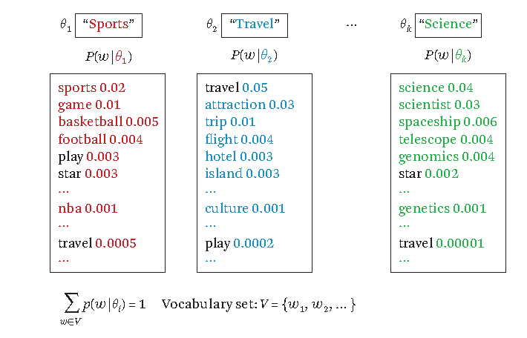
Introduction to Topic Modeling
Notes:
First, let's define NER!
go through pages, recognize the names of things: "Bill MacCartney", "Stanford University"
the people who came up with this task had a rather precise, philosophically motivated meaning in mind
entity: a discrete, actual thing: Bill MacCartney, but not calcium carbonate or Tuesday or Viagra
named entity: an entity with a name, in a philosophical, Kripke-like sense
(this water bottle is an entity, but not a NAMED entity)
but in practice the definition has been expanded quite a bit in later work
we routinely include dates & times, proteins, drug names
but still, loosely, things that have a name
but NOT references to entities which are not names: "this university", "it”
first task in NER: identifying occurrences of named entities
looking for capital letters is a really good clue! at least in English! but not so much in Hebrew, Chinese, ... non-Latinate alphabets also doesn't really work in German -- all nouns are capitalized!
so that's a pretty useful base-level task -- widely deployed and used
you've probably seen web pages that do this
e.g. financial web sites often mark up stock symbols, names of companies
Microsoft has done work with this, smart tags, entities tagged with metadata
Reuters has web service OpenCalais, you send them docs, they send back NER markup

Slide 13
Introduction to Topic Modeling
Next, we examine the task of discovering topics represented in this way.
Since the representation is a probability distribution, it is natural to use probabilistic models for discovering such word distributions → Probabilistic Topic Modeling.
Notes:
First, let's define NER!
go through pages, recognize the names of things: "Bill MacCartney", "Stanford University"
the people who came up with this task had a rather precise, philosophically motivated meaning in mind
entity: a discrete, actual thing: Bill MacCartney, but not calcium carbonate or Tuesday or Viagra
named entity: an entity with a name, in a philosophical, Kripke-like sense
(this water bottle is an entity, but not a NAMED entity)
but in practice the definition has been expanded quite a bit in later work
we routinely include dates & times, proteins, drug names
but still, loosely, things that have a name
but NOT references to entities which are not names: "this university", "it”
first task in NER: identifying occurrences of named entities
looking for capital letters is a really good clue! at least in English! but not so much in Hebrew, Chinese, ... non-Latinate alphabets also doesn't really work in German -- all nouns are capitalized!
so that's a pretty useful base-level task -- widely deployed and used
you've probably seen web pages that do this
e.g. financial web sites often mark up stock symbols, names of companies
Microsoft has done work with this, smart tags, entities tagged with metadata
Reuters has web service OpenCalais, you send them docs, they send back NER markup

Slide 14
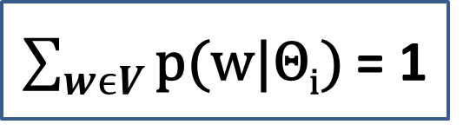
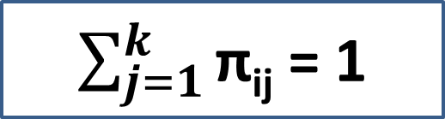
Formal Definition of Topic Mining and Analysis
Input:
A Collection of N text documents C={d₁,d₂,d₃…..d_{n}}
Vocabulary Set V = {w₁,w₂,w₃,….w_{m}}
Number of Topics: k.
Output:
K topics, each word distribution:{Θ₁, Θ₂,…. Θ_{k}}
Coverage of topics in each d_{i}:{π_{i1}, π_{i2},… π_{ik}}
Where π_{ij} is probability of d_{i} covering topic Θ_{j}
$\sum_{wϵV}{\text{p}\text{(}\text{w}\text{|}\text{Θ}\text{i}\text{)}}$ = 1
$\sum_{j=1}^{k}{\text{π}\text{ij}}$ = 1
Notes:
First, let's define NER!
go through pages, recognize the names of things: "Bill MacCartney", "Stanford University"
the people who came up with this task had a rather precise, philosophically motivated meaning in mind
entity: a discrete, actual thing: Bill MacCartney, but not calcium carbonate or Tuesday or Viagra
named entity: an entity with a name, in a philosophical, Kripke-like sense
(this water bottle is an entity, but not a NAMED entity)
but in practice the definition has been expanded quite a bit in later work
we routinely include dates & times, proteins, drug names
but still, loosely, things that have a name
but NOT references to entities which are not names: "this university", "it”
first task in NER: identifying occurrences of named entities
looking for capital letters is a really good clue! at least in English! but not so much in Hebrew, Chinese, ... non-Latinate alphabets also doesn't really work in German -- all nouns are capitalized!
so that's a pretty useful base-level task -- widely deployed and used
you've probably seen web pages that do this
e.g. financial web sites often mark up stock symbols, names of companies
Microsoft has done work with this, smart tags, entities tagged with metadata
Reuters has web service OpenCalais, you send them docs, they send back NER markup

Slide 15
Formal Definition of Topic Mining and Analysis
The output consists of two families of probability distributions.
Set of topics represented by a set of Θ_{i} ‘s. → each of which is a word distribution
topic coverage distribution for each document d_{i}:{π_{i1}, π_{i2},… π_{ik}}
Question is how to generate output from such input.
General way to solve this problem is called generative model. → uses principled way of using statistical modeling.
Notes:
First, let's define NER!
go through pages, recognize the names of things: "Bill MacCartney", "Stanford University"
the people who came up with this task had a rather precise, philosophically motivated meaning in mind
entity: a discrete, actual thing: Bill MacCartney, but not calcium carbonate or Tuesday or Viagra
named entity: an entity with a name, in a philosophical, Kripke-like sense
(this water bottle is an entity, but not a NAMED entity)
but in practice the definition has been expanded quite a bit in later work
we routinely include dates & times, proteins, drug names
but still, loosely, things that have a name
but NOT references to entities which are not names: "this university", "it”
first task in NER: identifying occurrences of named entities
looking for capital letters is a really good clue! at least in English! but not so much in Hebrew, Chinese, ... non-Latinate alphabets also doesn't really work in German -- all nouns are capitalized!
so that's a pretty useful base-level task -- widely deployed and used
you've probably seen web pages that do this
e.g. financial web sites often mark up stock symbols, names of companies
Microsoft has done work with this, smart tags, entities tagged with metadata
Reuters has web service OpenCalais, you send them docs, they send back NER markup

Slide 16
Generative Model
The basic idea of this approach is to first design generative model for data,
i.e probabilistic model to model how data are generated or
a model that can allow us to compute the probability of how likely we will observe the data we have
In general, model will have some parameters
These parameters controls the behavior of model by controlling the what kind of data would have high or low probabilities.
Design a model in such a way that its parameters would encode the knowledge, which the user want to discover.
Then, we attempt to estimate these parameters based on the data so as to generate the desired output in the form of parameter values, which we have designed to denote the knowledge we would like to discover.
How exactly we should fit the model to the data or infer the parameter values based on the data is often a standard problem in statistics.
Notes:
First, let's define NER!
go through pages, recognize the names of things: "Bill MacCartney", "Stanford University"
the people who came up with this task had a rather precise, philosophically motivated meaning in mind
entity: a discrete, actual thing: Bill MacCartney, but not calcium carbonate or Tuesday or Viagra
named entity: an entity with a name, in a philosophical, Kripke-like sense
(this water bottle is an entity, but not a NAMED entity)
but in practice the definition has been expanded quite a bit in later work
we routinely include dates & times, proteins, drug names
but still, loosely, things that have a name
but NOT references to entities which are not names: "this university", "it”
first task in NER: identifying occurrences of named entities
looking for capital letters is a really good clue! at least in English! but not so much in Hebrew, Chinese, ... non-Latinate alphabets also doesn't really work in German -- all nouns are capitalized!
so that's a pretty useful base-level task -- widely deployed and used
you've probably seen web pages that do this
e.g. financial web sites often mark up stock symbols, names of companies
Microsoft has done work with this, smart tags, entities tagged with metadata
Reuters has web service OpenCalais, you send them docs, they send back NER markup

Slide 17
Generative Model
The idea of using generative model to solve specific problem of discovering topics and topic coverage from text data.
Generative model needs to
contain all the k-word distribution representing topics.
the topic coverage distributions for all the documents.
Many parameters are available in generative model.
Parameters:
|V| k word probability parameters
N k topic coverage probability parameters
Total → |V|k+Nk
Notes:
First, let's define NER!
go through pages, recognize the names of things: "Bill MacCartney", "Stanford University"
the people who came up with this task had a rather precise, philosophically motivated meaning in mind
entity: a discrete, actual thing: Bill MacCartney, but not calcium carbonate or Tuesday or Viagra
named entity: an entity with a name, in a philosophical, Kripke-like sense
(this water bottle is an entity, but not a NAMED entity)
but in practice the definition has been expanded quite a bit in later work
we routinely include dates & times, proteins, drug names
but still, loosely, things that have a name
but NOT references to entities which are not names: "this university", "it”
first task in NER: identifying occurrences of named entities
looking for capital letters is a really good clue! at least in English! but not so much in Hebrew, Chinese, ... non-Latinate alphabets also doesn't really work in German -- all nouns are capitalized!
so that's a pretty useful base-level task -- widely deployed and used
you've probably seen web pages that do this
e.g. financial web sites often mark up stock symbols, names of companies
Microsoft has done work with this, smart tags, entities tagged with metadata
Reuters has web service OpenCalais, you send them docs, they send back NER markup

Slide 18
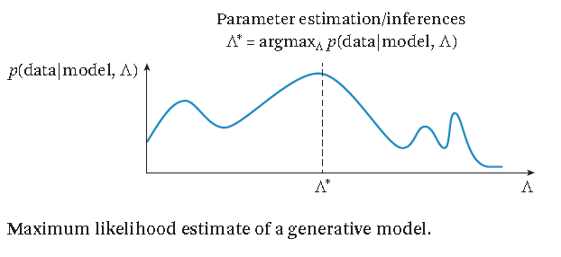
Generative Model
Once we set up the model, we can fit its parameters to our data.
i.e we can estimate the parameters or infer the parameters based on the data.
In other words, we would like to adjust these parameter values until we give our data set maximum probability.
Notes:
First, let's define NER!
go through pages, recognize the names of things: "Bill MacCartney", "Stanford University"
the people who came up with this task had a rather precise, philosophically motivated meaning in mind
entity: a discrete, actual thing: Bill MacCartney, but not calcium carbonate or Tuesday or Viagra
named entity: an entity with a name, in a philosophical, Kripke-like sense
(this water bottle is an entity, but not a NAMED entity)
but in practice the definition has been expanded quite a bit in later work
we routinely include dates & times, proteins, drug names
but still, loosely, things that have a name
but NOT references to entities which are not names: "this university", "it”
first task in NER: identifying occurrences of named entities
looking for capital letters is a really good clue! at least in English! but not so much in Hebrew, Chinese, ... non-Latinate alphabets also doesn't really work in German -- all nouns are capitalized!
so that's a pretty useful base-level task -- widely deployed and used
you've probably seen web pages that do this
e.g. financial web sites often mark up stock symbols, names of companies
Microsoft has done work with this, smart tags, entities tagged with metadata
Reuters has web service OpenCalais, you send them docs, they send back NER markup

Slide 19
Generative Model
Generative Model for topic modeling:
We design a model with some parameter values to describe the data as well as we can.
After, we have fit the data, we learn parameter values.
We treat the learned parameters as the discovered knowledge from text data.
Notes:
First, let's define NER!
go through pages, recognize the names of things: "Bill MacCartney", "Stanford University"
the people who came up with this task had a rather precise, philosophically motivated meaning in mind
entity: a discrete, actual thing: Bill MacCartney, but not calcium carbonate or Tuesday or Viagra
named entity: an entity with a name, in a philosophical, Kripke-like sense
(this water bottle is an entity, but not a NAMED entity)
but in practice the definition has been expanded quite a bit in later work
we routinely include dates & times, proteins, drug names
but still, loosely, things that have a name
but NOT references to entities which are not names: "this university", "it”
first task in NER: identifying occurrences of named entities
looking for capital letters is a really good clue! at least in English! but not so much in Hebrew, Chinese, ... non-Latinate alphabets also doesn't really work in German -- all nouns are capitalized!
so that's a pretty useful base-level task -- widely deployed and used
you've probably seen web pages that do this
e.g. financial web sites often mark up stock symbols, names of companies
Microsoft has done work with this, smart tags, entities tagged with metadata
Reuters has web service OpenCalais, you send them docs, they send back NER markup

Slide 20
Probabilistic Latent Semantic Analysis
It is a basic topic model.
It is a generalization of the two-component mixture model.
Task:
mine multiple topics from text documents.
compute the coverage of each topic in each document.
Assumptions:
A topic can be represented as a word distribution (more generally term distribution)
text document is a sample of words drawn from a probabilistic model.
Notes:
First, let's define NER!
go through pages, recognize the names of things: "Bill MacCartney", "Stanford University"
the people who came up with this task had a rather precise, philosophically motivated meaning in mind
entity: a discrete, actual thing: Bill MacCartney, but not calcium carbonate or Tuesday or Viagra
named entity: an entity with a name, in a philosophical, Kripke-like sense
(this water bottle is an entity, but not a NAMED entity)
but in practice the definition has been expanded quite a bit in later work
we routinely include dates & times, proteins, drug names
but still, loosely, things that have a name
but NOT references to entities which are not names: "this university", "it”
first task in NER: identifying occurrences of named entities
looking for capital letters is a really good clue! at least in English! but not so much in Hebrew, Chinese, ... non-Latinate alphabets also doesn't really work in German -- all nouns are capitalized!
so that's a pretty useful base-level task -- widely deployed and used
you've probably seen web pages that do this
e.g. financial web sites often mark up stock symbols, names of companies
Microsoft has done work with this, smart tags, entities tagged with metadata
Reuters has web service OpenCalais, you send them docs, they send back NER markup

Slide 21
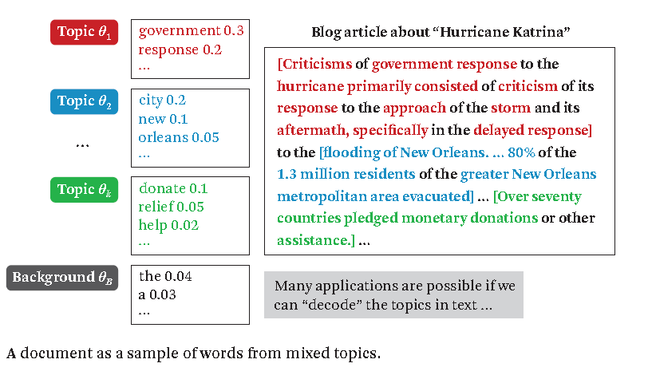
Probabilistic Latent Semantic Analysis
Notes:
First, let's define NER!
go through pages, recognize the names of things: "Bill MacCartney", "Stanford University"
the people who came up with this task had a rather precise, philosophically motivated meaning in mind
entity: a discrete, actual thing: Bill MacCartney, but not calcium carbonate or Tuesday or Viagra
named entity: an entity with a name, in a philosophical, Kripke-like sense
(this water bottle is an entity, but not a NAMED entity)
but in practice the definition has been expanded quite a bit in later work
we routinely include dates & times, proteins, drug names
but still, loosely, things that have a name
but NOT references to entities which are not names: "this university", "it”
first task in NER: identifying occurrences of named entities
looking for capital letters is a really good clue! at least in English! but not so much in Hebrew, Chinese, ... non-Latinate alphabets also doesn't really work in German -- all nouns are capitalized!
so that's a pretty useful base-level task -- widely deployed and used
you've probably seen web pages that do this
e.g. financial web sites often mark up stock symbols, names of companies
Microsoft has done work with this, smart tags, entities tagged with metadata
Reuters has web service OpenCalais, you send them docs, they send back NER markup

Slide 22
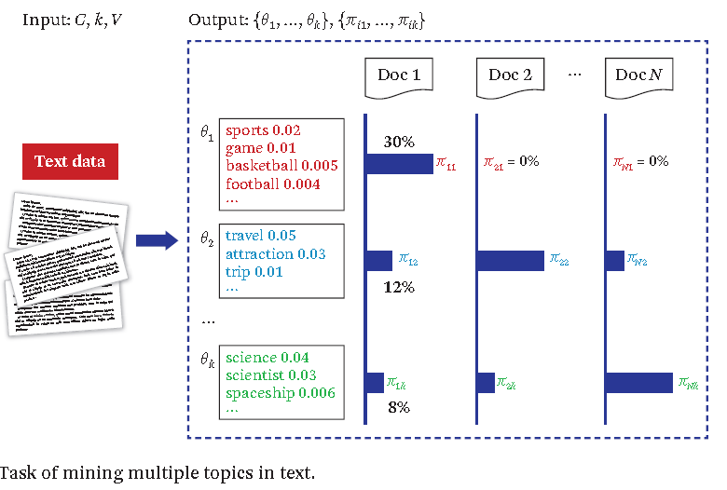
Probabilistic Latent Semantic Analysis
Notes:
First, let's define NER!
go through pages, recognize the names of things: "Bill MacCartney", "Stanford University"
the people who came up with this task had a rather precise, philosophically motivated meaning in mind
entity: a discrete, actual thing: Bill MacCartney, but not calcium carbonate or Tuesday or Viagra
named entity: an entity with a name, in a philosophical, Kripke-like sense
(this water bottle is an entity, but not a NAMED entity)
but in practice the definition has been expanded quite a bit in later work
we routinely include dates & times, proteins, drug names
but still, loosely, things that have a name
but NOT references to entities which are not names: "this university", "it”
first task in NER: identifying occurrences of named entities
looking for capital letters is a really good clue! at least in English! but not so much in Hebrew, Chinese, ... non-Latinate alphabets also doesn't really work in German -- all nouns are capitalized!
so that's a pretty useful base-level task -- widely deployed and used
you've probably seen web pages that do this
e.g. financial web sites often mark up stock symbols, names of companies
Microsoft has done work with this, smart tags, entities tagged with metadata
Reuters has web service OpenCalais, you send them docs, they send back NER markup

Slide 23
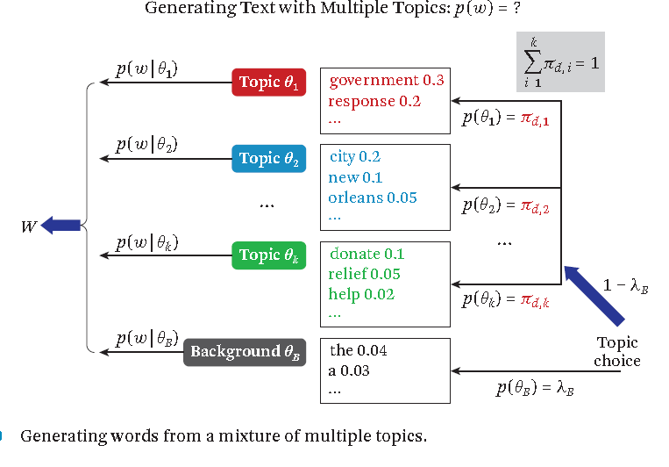
Probabilistic Latent Semantic Analysis
Notes:
First, let's define NER!
go through pages, recognize the names of things: "Bill MacCartney", "Stanford University"
the people who came up with this task had a rather precise, philosophically motivated meaning in mind
entity: a discrete, actual thing: Bill MacCartney, but not calcium carbonate or Tuesday or Viagra
named entity: an entity with a name, in a philosophical, Kripke-like sense
(this water bottle is an entity, but not a NAMED entity)
but in practice the definition has been expanded quite a bit in later work
we routinely include dates & times, proteins, drug names
but still, loosely, things that have a name
but NOT references to entities which are not names: "this university", "it”
first task in NER: identifying occurrences of named entities
looking for capital letters is a really good clue! at least in English! but not so much in Hebrew, Chinese, ... non-Latinate alphabets also doesn't really work in German -- all nouns are capitalized!
so that's a pretty useful base-level task -- widely deployed and used
you've probably seen web pages that do this
e.g. financial web sites often mark up stock symbols, names of companies
Microsoft has done work with this, smart tags, entities tagged with metadata
Reuters has web service OpenCalais, you send them docs, they send back NER markup

Slide 24
Probabilistic Latent Semantic Analysis
It has k-component models, each of which represents a distinct topic and can be used to generate a word in the observed text data.
One background model (Θ_{B})used in the two-component mixture model.
As in the case of the simple mixture model, the process of generating a word still consists of two steps.
choose a component model to use. This decision is controlled by both a parameter (the probability of choosing the background model) and the probability of choosing topic
the generation process is simply to draw a word from the selected distribution, exactly the same as in the simple mixture model.
Notes:
First, let's define NER!
go through pages, recognize the names of things: "Bill MacCartney", "Stanford University"
the people who came up with this task had a rather precise, philosophically motivated meaning in mind
entity: a discrete, actual thing: Bill MacCartney, but not calcium carbonate or Tuesday or Viagra
named entity: an entity with a name, in a philosophical, Kripke-like sense
(this water bottle is an entity, but not a NAMED entity)
but in practice the definition has been expanded quite a bit in later work
we routinely include dates & times, proteins, drug names
but still, loosely, things that have a name
but NOT references to entities which are not names: "this university", "it”
first task in NER: identifying occurrences of named entities
looking for capital letters is a really good clue! at least in English! but not so much in Hebrew, Chinese, ... non-Latinate alphabets also doesn't really work in German -- all nouns are capitalized!
so that's a pretty useful base-level task -- widely deployed and used
you've probably seen web pages that do this
e.g. financial web sites often mark up stock symbols, names of companies
Microsoft has done work with this, smart tags, entities tagged with metadata
Reuters has web service OpenCalais, you send them docs, they send back NER markup

Slide 25
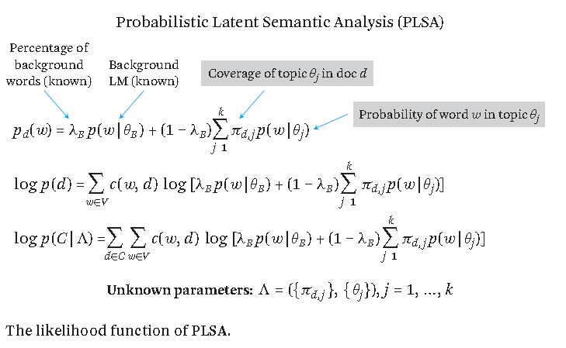
Probabilistic Latent Semantic Analysis
Notes:
First, let's define NER!
go through pages, recognize the names of things: "Bill MacCartney", "Stanford University"
the people who came up with this task had a rather precise, philosophically motivated meaning in mind
entity: a discrete, actual thing: Bill MacCartney, but not calcium carbonate or Tuesday or Viagra
named entity: an entity with a name, in a philosophical, Kripke-like sense
(this water bottle is an entity, but not a NAMED entity)
but in practice the definition has been expanded quite a bit in later work
we routinely include dates & times, proteins, drug names
but still, loosely, things that have a name
but NOT references to entities which are not names: "this university", "it”
first task in NER: identifying occurrences of named entities
looking for capital letters is a really good clue! at least in English! but not so much in Hebrew, Chinese, ... non-Latinate alphabets also doesn't really work in German -- all nouns are capitalized!
so that's a pretty useful base-level task -- widely deployed and used
you've probably seen web pages that do this
e.g. financial web sites often mark up stock symbols, names of companies
Microsoft has done work with this, smart tags, entities tagged with metadata
Reuters has web service OpenCalais, you send them docs, they send back NER markup

Slide 26
Extension to PLSA
PLSA
completely unsupervised method for analyzing topics in text data → no manual effort.
Topics are discovered by driven the data characteristics with out any consideration of extra knowledge about topics and their coverage in the dataset.
If we have such extra knowledge or application imposes a particular preferences for the topics → impose some prior knowledge about the parameters to be estimated.
Prior knowledge or preferences may be available for all the parameters.
Notes:
First, let's define NER!
go through pages, recognize the names of things: "Bill MacCartney", "Stanford University"
the people who came up with this task had a rather precise, philosophically motivated meaning in mind
entity: a discrete, actual thing: Bill MacCartney, but not calcium carbonate or Tuesday or Viagra
named entity: an entity with a name, in a philosophical, Kripke-like sense
(this water bottle is an entity, but not a NAMED entity)
but in practice the definition has been expanded quite a bit in later work
we routinely include dates & times, proteins, drug names
but still, loosely, things that have a name
but NOT references to entities which are not names: "this university", "it”
first task in NER: identifying occurrences of named entities
looking for capital letters is a really good clue! at least in English! but not so much in Hebrew, Chinese, ... non-Latinate alphabets also doesn't really work in German -- all nouns are capitalized!
so that's a pretty useful base-level task -- widely deployed and used
you've probably seen web pages that do this
e.g. financial web sites often mark up stock symbols, names of companies
Microsoft has done work with this, smart tags, entities tagged with metadata
Reuters has web service OpenCalais, you send them docs, they send back NER markup

Slide 27
Extension to PLSA
A user may have some expectations about which topics to analyze in the text data, and such knowledge can be used to define a prior on the topic word distributions.
Example:
a user may be interested in analyzing review data about a laptop with a focus on specific aspects such as battery life and screen size, → thus we again want the model to allocate two topics for battery life and screen size, respectively.
Notes:
First, let's define NER!
go through pages, recognize the names of things: "Bill MacCartney", "Stanford University"
the people who came up with this task had a rather precise, philosophically motivated meaning in mind
entity: a discrete, actual thing: Bill MacCartney, but not calcium carbonate or Tuesday or Viagra
named entity: an entity with a name, in a philosophical, Kripke-like sense
(this water bottle is an entity, but not a NAMED entity)
but in practice the definition has been expanded quite a bit in later work
we routinely include dates & times, proteins, drug names
but still, loosely, things that have a name
but NOT references to entities which are not names: "this university", "it”
first task in NER: identifying occurrences of named entities
looking for capital letters is a really good clue! at least in English! but not so much in Hebrew, Chinese, ... non-Latinate alphabets also doesn't really work in German -- all nouns are capitalized!
so that's a pretty useful base-level task -- widely deployed and used
you've probably seen web pages that do this
e.g. financial web sites often mark up stock symbols, names of companies
Microsoft has done work with this, smart tags, entities tagged with metadata
Reuters has web service OpenCalais, you send them docs, they send back NER markup

Slide 28
Extension to PLSA
Users may have knowledge about what topics are (or are not) covered in a document.
tags assigned to documents by users.
A prior knowledge can be incorporated into PLSA by using Maximum A Posteriori Estimation (MAP) instead of Maximum Likelihood estimation.
The prior distribution can be helpful
Topic characterization
Topic coverage
Notes:
First, let's define NER!
go through pages, recognize the names of things: "Bill MacCartney", "Stanford University"
the people who came up with this task had a rather precise, philosophically motivated meaning in mind
entity: a discrete, actual thing: Bill MacCartney, but not calcium carbonate or Tuesday or Viagra
named entity: an entity with a name, in a philosophical, Kripke-like sense
(this water bottle is an entity, but not a NAMED entity)
but in practice the definition has been expanded quite a bit in later work
we routinely include dates & times, proteins, drug names
but still, loosely, things that have a name
but NOT references to entities which are not names: "this university", "it”
first task in NER: identifying occurrences of named entities
looking for capital letters is a really good clue! at least in English! but not so much in Hebrew, Chinese, ... non-Latinate alphabets also doesn't really work in German -- all nouns are capitalized!
so that's a pretty useful base-level task -- widely deployed and used
you've probably seen web pages that do this
e.g. financial web sites often mark up stock symbols, names of companies
Microsoft has done work with this, smart tags, entities tagged with metadata
Reuters has web service OpenCalais, you send them docs, they send back NER markup

Slide 29

Extension to PLSA
With such prior, we can estimate parameters by using MAP as follows:
There are many different ways to define p(Λ).
It is convenient to use conjugative prior distribution.
posterior distribution is written as a function of the parameter, so the maximization of the posterior probability would be similar to the maximization of the likelihood function.
Notes:
First, let's define NER!
go through pages, recognize the names of things: "Bill MacCartney", "Stanford University"
the people who came up with this task had a rather precise, philosophically motivated meaning in mind
entity: a discrete, actual thing: Bill MacCartney, but not calcium carbonate or Tuesday or Viagra
named entity: an entity with a name, in a philosophical, Kripke-like sense
(this water bottle is an entity, but not a NAMED entity)
but in practice the definition has been expanded quite a bit in later work
we routinely include dates & times, proteins, drug names
but still, loosely, things that have a name
but NOT references to entities which are not names: "this university", "it”
first task in NER: identifying occurrences of named entities
looking for capital letters is a really good clue! at least in English! but not so much in Hebrew, Chinese, ... non-Latinate alphabets also doesn't really work in German -- all nouns are capitalized!
so that's a pretty useful base-level task -- widely deployed and used
you've probably seen web pages that do this
e.g. financial web sites often mark up stock symbols, names of companies
Microsoft has done work with this, smart tags, entities tagged with metadata
Reuters has web service OpenCalais, you send them docs, they send back NER markup

Slide 30
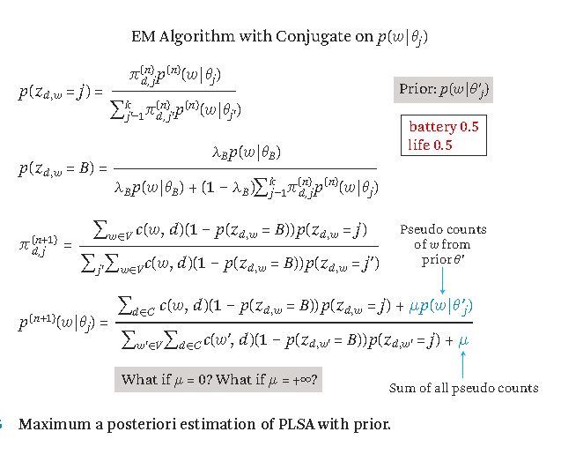
Extension to PLSA
When using such a conjugate prior, the computation of MAP can be done by using a slightly modified version of the EM algorithm
Notes:
First, let's define NER!
go through pages, recognize the names of things: "Bill MacCartney", "Stanford University"
the people who came up with this task had a rather precise, philosophically motivated meaning in mind
entity: a discrete, actual thing: Bill MacCartney, but not calcium carbonate or Tuesday or Viagra
named entity: an entity with a name, in a philosophical, Kripke-like sense
(this water bottle is an entity, but not a NAMED entity)
but in practice the definition has been expanded quite a bit in later work
we routinely include dates & times, proteins, drug names
but still, loosely, things that have a name
but NOT references to entities which are not names: "this university", "it”
first task in NER: identifying occurrences of named entities
looking for capital letters is a really good clue! at least in English! but not so much in Hebrew, Chinese, ... non-Latinate alphabets also doesn't really work in German -- all nouns are capitalized!
so that's a pretty useful base-level task -- widely deployed and used
you've probably seen web pages that do this
e.g. financial web sites often mark up stock symbols, names of companies
Microsoft has done work with this, smart tags, entities tagged with metadata
Reuters has web service OpenCalais, you send them docs, they send back NER markup

Slide 31
Extension to PLSA
The difference is pseudo count for a word for word w in M-step which is propositional to the probability of word in the prior.
μ ϵ [0,+ꝏ)
μ =0 → original EM algorithm in PLSA → no prior influence
μ = + ꝏ → strong prior influence → word distribution is fixed to prior.
In bayesian inference, if the prior is infinitely strong, then no matter how much data we collect, we will not be able to override the prior.
Notes:
First, let's define NER!
go through pages, recognize the names of things: "Bill MacCartney", "Stanford University"
the people who came up with this task had a rather precise, philosophically motivated meaning in mind
entity: a discrete, actual thing: Bill MacCartney, but not calcium carbonate or Tuesday or Viagra
named entity: an entity with a name, in a philosophical, Kripke-like sense
(this water bottle is an entity, but not a NAMED entity)
but in practice the definition has been expanded quite a bit in later work
we routinely include dates & times, proteins, drug names
but still, loosely, things that have a name
but NOT references to entities which are not names: "this university", "it”
first task in NER: identifying occurrences of named entities
looking for capital letters is a really good clue! at least in English! but not so much in Hebrew, Chinese, ... non-Latinate alphabets also doesn't really work in German -- all nouns are capitalized!
so that's a pretty useful base-level task -- widely deployed and used
you've probably seen web pages that do this
e.g. financial web sites often mark up stock symbols, names of companies
Microsoft has done work with this, smart tags, entities tagged with metadata
Reuters has web service OpenCalais, you send them docs, they send back NER markup

Slide 32
Extension to PLSA
In general, as data increases, then data dominates the estimate. → override the prior completely, if we have infinite data.
Similar kind of effect will be taking place on topic coverage distribution in documents also.
PLSA is a generative model for modeling word in a documents.
But, PLSA is not a generative model for documents.
since it cannot give a probability of a new unseen document.
it cannot give a distribution over all the possible documents.
Notes:
First, let's define NER!
go through pages, recognize the names of things: "Bill MacCartney", "Stanford University"
the people who came up with this task had a rather precise, philosophically motivated meaning in mind
entity: a discrete, actual thing: Bill MacCartney, but not calcium carbonate or Tuesday or Viagra
named entity: an entity with a name, in a philosophical, Kripke-like sense
(this water bottle is an entity, but not a NAMED entity)
but in practice the definition has been expanded quite a bit in later work
we routinely include dates & times, proteins, drug names
but still, loosely, things that have a name
but NOT references to entities which are not names: "this university", "it”
first task in NER: identifying occurrences of named entities
looking for capital letters is a really good clue! at least in English! but not so much in Hebrew, Chinese, ... non-Latinate alphabets also doesn't really work in German -- all nouns are capitalized!
so that's a pretty useful base-level task -- widely deployed and used
you've probably seen web pages that do this
e.g. financial web sites often mark up stock symbols, names of companies
Microsoft has done work with this, smart tags, entities tagged with metadata
Reuters has web service OpenCalais, you send them docs, they send back NER markup

Slide 33
Extension to PLSA
Difficulty in Extension of PLSA:
This PLSA will be working on observed documents.
Topic coverage is difficult in unseen document, if we are using Extension of PLSA.
Do not have a model that coverage of topics in a new unseen document. → inorder to generate words in a new documents.
Many heuristic approaches are available to estimate the topic coverage in unseen documents.
One solution is, add prior on parameters of PLSA and make a bayesian version of the model. → LDA
Notes:
First, let's define NER!
go through pages, recognize the names of things: "Bill MacCartney", "Stanford University"
the people who came up with this task had a rather precise, philosophically motivated meaning in mind
entity: a discrete, actual thing: Bill MacCartney, but not calcium carbonate or Tuesday or Viagra
named entity: an entity with a name, in a philosophical, Kripke-like sense
(this water bottle is an entity, but not a NAMED entity)
but in practice the definition has been expanded quite a bit in later work
we routinely include dates & times, proteins, drug names
but still, loosely, things that have a name
but NOT references to entities which are not names: "this university", "it”
first task in NER: identifying occurrences of named entities
looking for capital letters is a really good clue! at least in English! but not so much in Hebrew, Chinese, ... non-Latinate alphabets also doesn't really work in German -- all nouns are capitalized!
so that's a pretty useful base-level task -- widely deployed and used
you've probably seen web pages that do this
e.g. financial web sites often mark up stock symbols, names of companies
Microsoft has done work with this, smart tags, entities tagged with metadata
Reuters has web service OpenCalais, you send them docs, they send back NER markup

Slide 34
LDA (Latent Dirichlet Allocation)
A Generative probabilistic model for collections of discrete data such as text corpora.
It is a three-level hierarchical Bayesian model.
The topic coverage distribution (a multinomial distribution) for each document is assumed to be drawn from a prior Dirichlet distribution.
a distribution over the entire space of the parameters of a multinomial distribution. → vector probabilities of topics.
Word Distribution representing the latent topics in a collection of text, it is also drawn from dirichlet distribution.
Notes:
First, let's define NER!
go through pages, recognize the names of things: "Bill MacCartney", "Stanford University"
the people who came up with this task had a rather precise, philosophically motivated meaning in mind
entity: a discrete, actual thing: Bill MacCartney, but not calcium carbonate or Tuesday or Viagra
named entity: an entity with a name, in a philosophical, Kripke-like sense
(this water bottle is an entity, but not a NAMED entity)
but in practice the definition has been expanded quite a bit in later work
we routinely include dates & times, proteins, drug names
but still, loosely, things that have a name
but NOT references to entities which are not names: "this university", "it”
first task in NER: identifying occurrences of named entities
looking for capital letters is a really good clue! at least in English! but not so much in Hebrew, Chinese, ... non-Latinate alphabets also doesn't really work in German -- all nouns are capitalized!
so that's a pretty useful base-level task -- widely deployed and used
you've probably seen web pages that do this
e.g. financial web sites often mark up stock symbols, names of companies
Microsoft has done work with this, smart tags, entities tagged with metadata
Reuters has web service OpenCalais, you send them docs, they send back NER markup

Slide 35
LDA (Latent Dirichlet Allocation)
LDA has parameters to characterize the Dirichlet distribution for topic coverage and word distribution.
Once parameters are fixed → behavior of dirichlet distributions are fixed → behavior of entire generative model is also fixed.
Notes:
First, let's define NER!
go through pages, recognize the names of things: "Bill MacCartney", "Stanford University"
the people who came up with this task had a rather precise, philosophically motivated meaning in mind
entity: a discrete, actual thing: Bill MacCartney, but not calcium carbonate or Tuesday or Viagra
named entity: an entity with a name, in a philosophical, Kripke-like sense
(this water bottle is an entity, but not a NAMED entity)
but in practice the definition has been expanded quite a bit in later work
we routinely include dates & times, proteins, drug names
but still, loosely, things that have a name
but NOT references to entities which are not names: "this university", "it”
first task in NER: identifying occurrences of named entities
looking for capital letters is a really good clue! at least in English! but not so much in Hebrew, Chinese, ... non-Latinate alphabets also doesn't really work in German -- all nouns are capitalized!
so that's a pretty useful base-level task -- widely deployed and used
you've probably seen web pages that do this
e.g. financial web sites often mark up stock symbols, names of companies
Microsoft has done work with this, smart tags, entities tagged with metadata
Reuters has web service OpenCalais, you send them docs, they send back NER markup

Slide 36
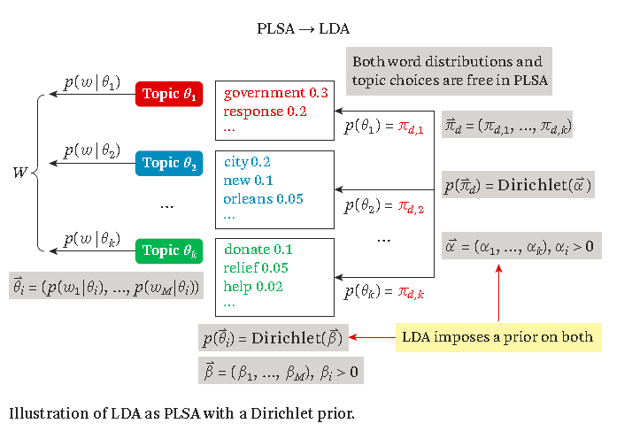
LDA (Latent Dirichlet Allocation)
Notes:
First, let's define NER!
go through pages, recognize the names of things: "Bill MacCartney", "Stanford University"
the people who came up with this task had a rather precise, philosophically motivated meaning in mind
entity: a discrete, actual thing: Bill MacCartney, but not calcium carbonate or Tuesday or Viagra
named entity: an entity with a name, in a philosophical, Kripke-like sense
(this water bottle is an entity, but not a NAMED entity)
but in practice the definition has been expanded quite a bit in later work
we routinely include dates & times, proteins, drug names
but still, loosely, things that have a name
but NOT references to entities which are not names: "this university", "it”
first task in NER: identifying occurrences of named entities
looking for capital letters is a really good clue! at least in English! but not so much in Hebrew, Chinese, ... non-Latinate alphabets also doesn't really work in German -- all nouns are capitalized!
so that's a pretty useful base-level task -- widely deployed and used
you've probably seen web pages that do this
e.g. financial web sites often mark up stock symbols, names of companies
Microsoft has done work with this, smart tags, entities tagged with metadata
Reuters has web service OpenCalais, you send them docs, they send back NER markup

Slide 37
LDA (Latent Dirichlet Allocation)
Topic coverage has k-parameters, α₁,α₂,.. α_{k}.
Each α_{i} can be interpreted as the pseudo count of the corresponding topic θ_{i} according to our prior
Topic word distribution has M-parameters, β₁, β₂,… β_{M}.
each β_{i} can be interpreted as the pseudo count of the corresponding word w_{i} according to our prior.
Notes:
First, let's define NER!
go through pages, recognize the names of things: "Bill MacCartney", "Stanford University"
the people who came up with this task had a rather precise, philosophically motivated meaning in mind
entity: a discrete, actual thing: Bill MacCartney, but not calcium carbonate or Tuesday or Viagra
named entity: an entity with a name, in a philosophical, Kripke-like sense
(this water bottle is an entity, but not a NAMED entity)
but in practice the definition has been expanded quite a bit in later work
we routinely include dates & times, proteins, drug names
but still, loosely, things that have a name
but NOT references to entities which are not names: "this university", "it”
first task in NER: identifying occurrences of named entities
looking for capital letters is a really good clue! at least in English! but not so much in Hebrew, Chinese, ... non-Latinate alphabets also doesn't really work in German -- all nouns are capitalized!
so that's a pretty useful base-level task -- widely deployed and used
you've probably seen web pages that do this
e.g. financial web sites often mark up stock symbols, names of companies
Microsoft has done work with this, smart tags, entities tagged with metadata
Reuters has web service OpenCalais, you send them docs, they send back NER markup

Slide 38
Latent Dirichlet Allocation ^{[Blei et al. 02]}
Make pLSA a fully generative model by imposing Dirichlet priors
Dirichlet priors over p(π|d)
Dirichlet priors over p(w|θ)
A Bayesian version of pLSA
Provide mechanism to deal with new documents
Flexible to model many other observations in a document

Slide 39
LDA = Imposing Prior on PLSA
pLSA:
Topic coverage π_{d,j} is specific to each “training document”, thus can’t be used to generate a new document
Topic coverage in document d
{π_{d,j} } are free for tuning
π_{d,1}
“Generating” word w
in doc d in the collection
θ₁
θ₂
W
π_{d,2}
LDA:
Topic coverage distribution {π_{d,j} } for any document is sampled from a Dirichlet distribution, allowing for generating a new doc
π_{d, k}
θ_{k}
{π_{d,j} } are regularized
Magnitudes of α and β
determine the variances of the prior,
thus also the concentration of prior
(larger α and β ➔ stronger prior)
In addition, the topic word distributions {θ_{j} } are also drawn from another Dirichlet prior

Slide 40
pLSA v.s. LDA
pLSA
Core assumption
in all topic models
pLSA component
LDA
Regularization
added by LDA

Slide 41


LDA (Latent Dirichlet Allocation)
The MLE to estimate its parameters
We need to use bayesian inference, to obtain values of latent variables in LDA.
Compute p({θ_{i}}, {π_{d} , j} | C, α, β) using bayes rule
This gives posterior distribution over all possible values of the interesting variables, from which we can then further obtain a point estimate or compute other interesting properties that depend on the distribution. → Gibbs sampling
Notes:
First, let's define NER!
go through pages, recognize the names of things: "Bill MacCartney", "Stanford University"
the people who came up with this task had a rather precise, philosophically motivated meaning in mind
entity: a discrete, actual thing: Bill MacCartney, but not calcium carbonate or Tuesday or Viagra
named entity: an entity with a name, in a philosophical, Kripke-like sense
(this water bottle is an entity, but not a NAMED entity)
but in practice the definition has been expanded quite a bit in later work
we routinely include dates & times, proteins, drug names
but still, loosely, things that have a name
but NOT references to entities which are not names: "this university", "it”
first task in NER: identifying occurrences of named entities
looking for capital letters is a really good clue! at least in English! but not so much in Hebrew, Chinese, ... non-Latinate alphabets also doesn't really work in German -- all nouns are capitalized!
so that's a pretty useful base-level task -- widely deployed and used
you've probably seen web pages that do this
e.g. financial web sites often mark up stock symbols, names of companies
Microsoft has done work with this, smart tags, entities tagged with metadata
Reuters has web service OpenCalais, you send them docs, they send back NER markup

Slide 42
LDA as a graphical model ^{[Blei et al. 03a]}
α
distribution over topics
for each document
(same as π_{d} on the previous slides)
Dirichlet priors
θ ^{(d)}
θ ^{(d)} ∼ Dirichlet(α)
β
topic assignment
for each word
distribution over words for
each topic
(same as θ _{j} on the previous slides)
z_{i}
z_{i} ∼ Discrete(θ ^{(d)} )
φ ^{(j)}
φ ^{(j)} ∼ Dirichlet(β)
T
word generated from
assigned topic
w_{i}
w_{i} ∼ Discrete(φ ^{(zi)} )
N_{d}
D
Most approximate inference algorithms aim to infer
from which other interesting variables can be easily computed

